Slide 1
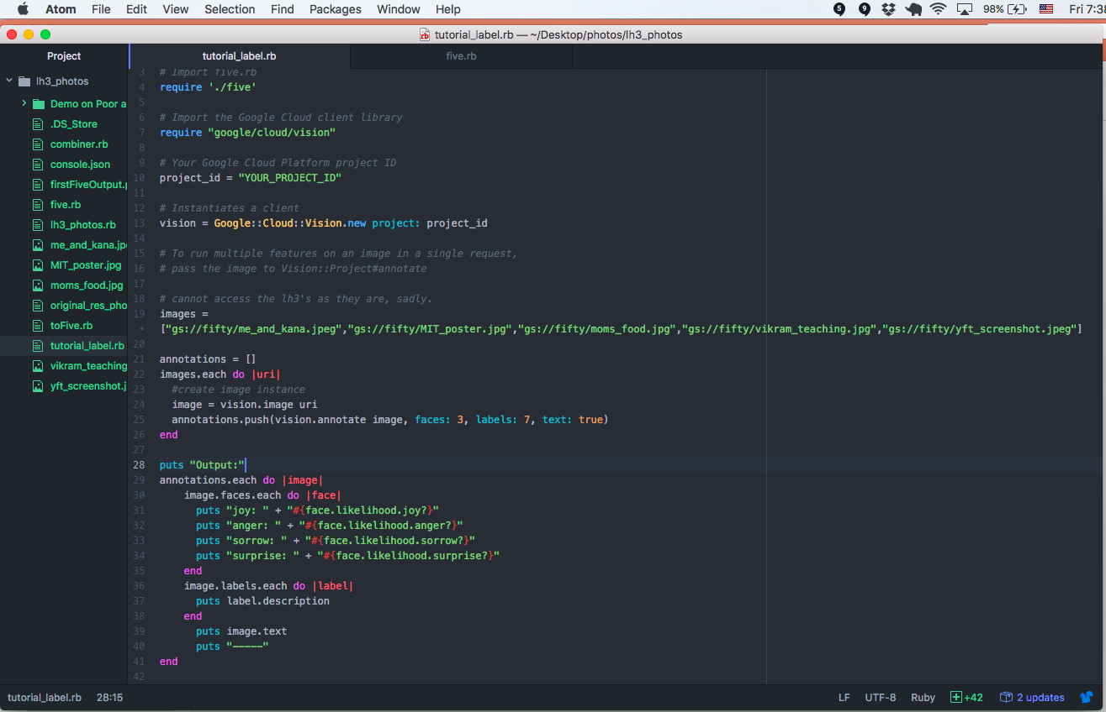
On a Friday afternoon, I did some coding, running a random set of five (of > five thousand) pictures from my Google Photos through an automated image analysis tool. Wanted to detect faces, label images, and get any text. These are the results.

Slide 2
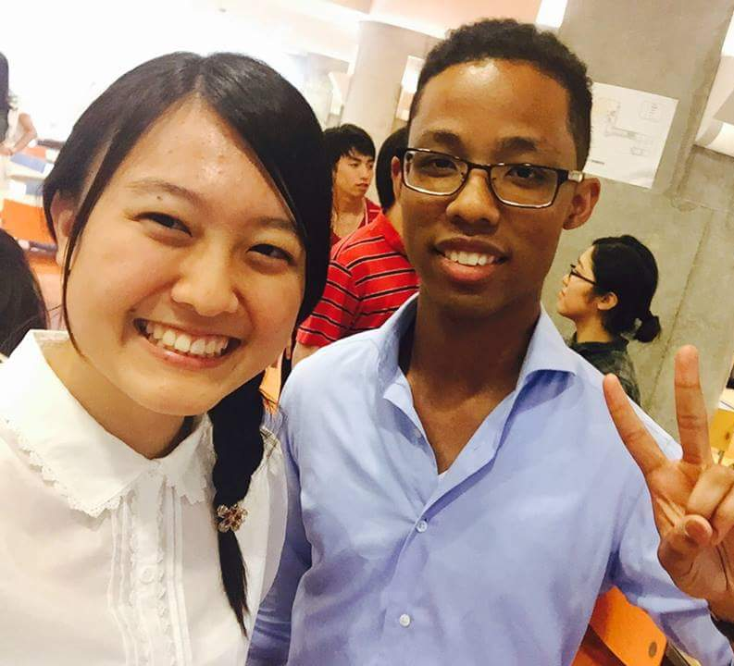
Me & Student
Face #1
joy: true
anger: false
sorrow: false
surprise: false
Face #2
joy: true
anger: false
sorrow: false
surprise: false
Face #3
joy: false
anger: false
sorrow: false
surprise: false
Labels:
food
socialite
smile
professional
fun
product
girl
Notes:
What a nice shirt that was though. I miss it.

Slide 3
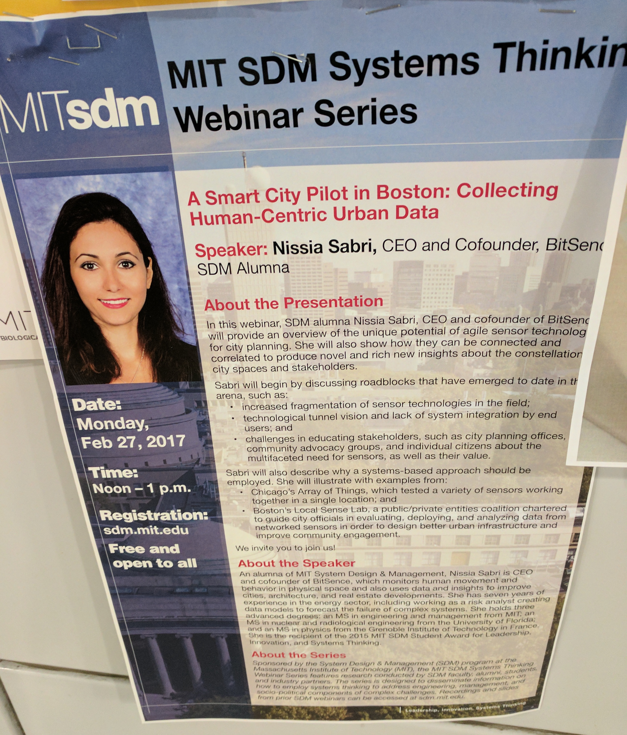
MIT Poster
Face:
joy: true
anger: false
sorrow: false
surprise: false
Labels:
advertising
product
Font
Notes:
Taken at MIT. Sometimes I take pictures of events when I don’t have time to enter into my calendar.
It spies the smiling lady. Realizes this I san ad, which is pretty crazy.

Slide 4
MIT Poster
Text:
MIT SDM Systems Thinkin
II Webinar Series
MITsdm
A Smart City Pilot in Boston: Collecting
Human-Centric Urban Data
Speaker: Nissia Sabri, CEO and Cofounder, BitSen
SDM Alumna
About the Presentation
In this webinar, SDM alumna Nissia Sabri, CEO and cofounder of Bitsen
will provide an overview of the unique potential of agile sensor technolo
ity planning. She will also show how they can be connected and
correlated to produce novel and rich new insights about the constellation
BIOLOGIC
city spaces and stakeholders
Sabri will begin by discussing roadblocks that have emerged to date in th
arena, such as:
Date
Monday,
Feb 27, 2017
increased fragmentation of sensor technologies in the field
technological tunnel vision and lack of system integration by end
users; and
. challenges in educating stakeholders, such as city planning offices
community advocacy groups, and individual citizens about the
multifaceted need for sensors, as well as their value
Time:
Noon-1 p.m.
Sabri will also describe why a systems-based approach should be
employed. She will illustrate with examples from:
. Chicago's Array of Things, which tested a variety of sensors working
together in a single location; and
.Boston's Local Sense Lab, a public/private entities coalition chartered
Registration:
to guide city officials in evaluating, deploying, and analyzing data from
networked sensors in order to design better urban infrastructure and
Notes:
Look how the machine reads from left to right, top to bottom. Doesn’t care that there are columns.
Pretty accurate, though it can’t infer what the cut-off words are trying to spell.

Slide 5
MIT Poster
improve community engagemen
sdm.mit.edu
Free and
open to all
We invite you to join us
About the Speaker
An alumna of MIT System Design & Management, Nissia Sabri is CEO
and cofounder of BitSence, which monitors human movement and
behavior in physical space and also uses data and insights to improve
cities, architecture, and real estate developments. She has seven years
experience in the energy sector, including working as a risk analyst cre
data models to forecast the failure of complex systems. She holds three
advanced degrees: an MS in engineering and management from MT an
of
MS in nuclear and radiological engineering from the University
of Florida
and an MS in physics from the Grenoble Institute of Technology in
She is the recipient of the 2015 MIT SDM Student Award for Leadership
nnovation, and Systems Thinking
About the Series
the
Sponsored by the System Design& Management (SD program a
Massachusetts Institute of Technology (MIT), the MIT SDM System
s Thinking
ni, studen
Webinar Series
and industry partners. The seres is designed to disseminate in
how to employ systems thinking to address engineering, manage
res research con
ucted by SDM faculty alum
ninate infomati
men
ocio Dolitical components of complex challenges. Recorcdings a
rom prior SDM webinars can be accessed at sdm.mit.edu
Notes:
Look how it makes more mistakes as the words get blurrier!

Slide 6
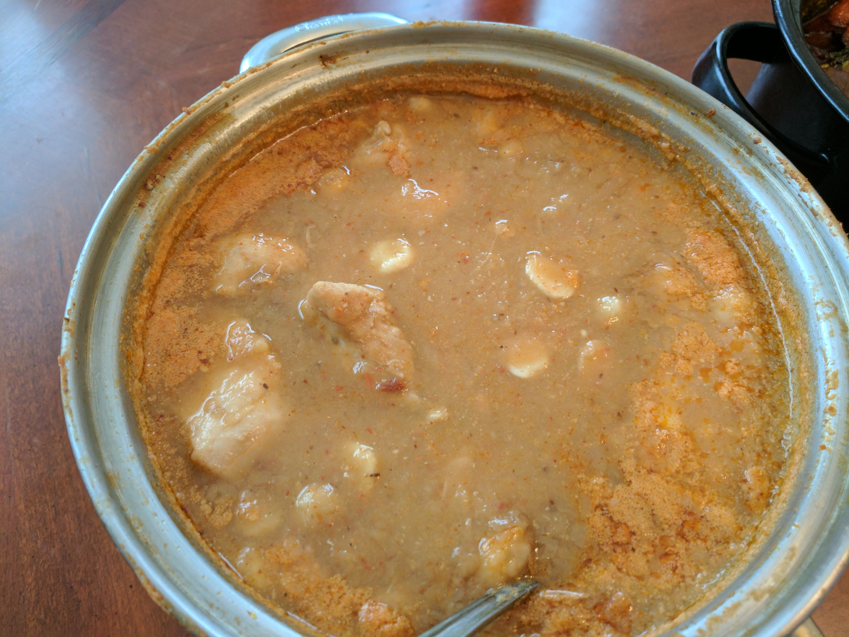
Mom’s food
Labels:
dish
gravy
curry
indian cuisine
cuisine
cookware and bakeware
food
Notes:
White bean and chicken soup. Made with some other stuff. I’ll ask mom. Very good stuff. Not Indian though, lol that’s racist Google. Thanksgiving 2016.

Slide 7
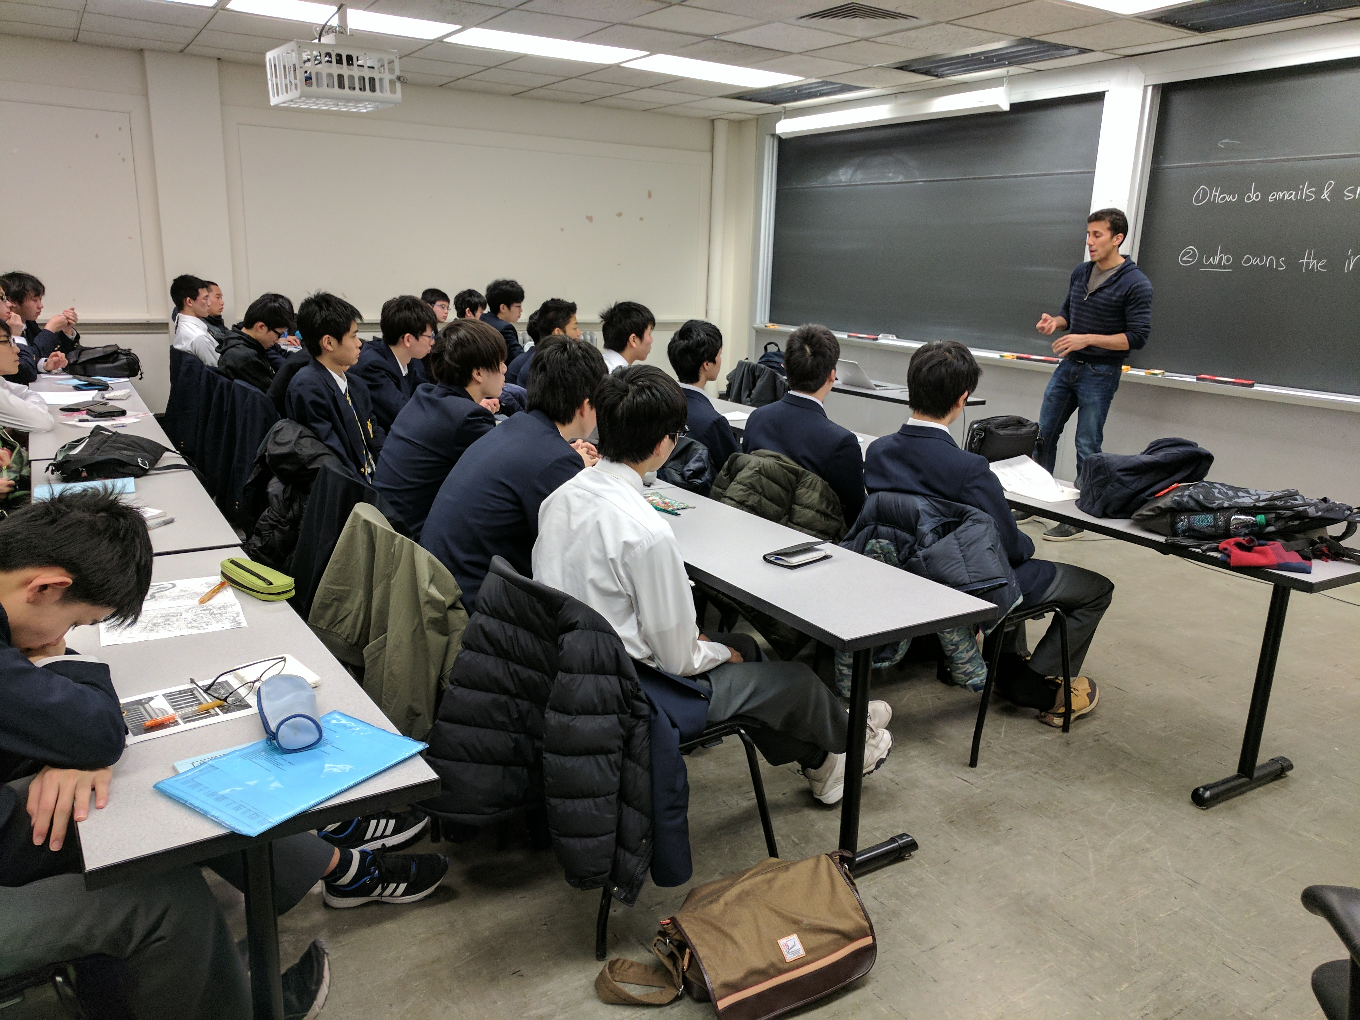
Vikram teaching
No faces showed emotion hehe
Labels:
seminar
technology
institution
meeting
job
training
Communication
Text:
OHow do emails R s
②ulo owns the i
Notes:
Vikram, need to get some emotion in here lol. The students are always falling asleep haha
Pretty crazy how the AI is able to pull out the writing on the board.

Slide 8
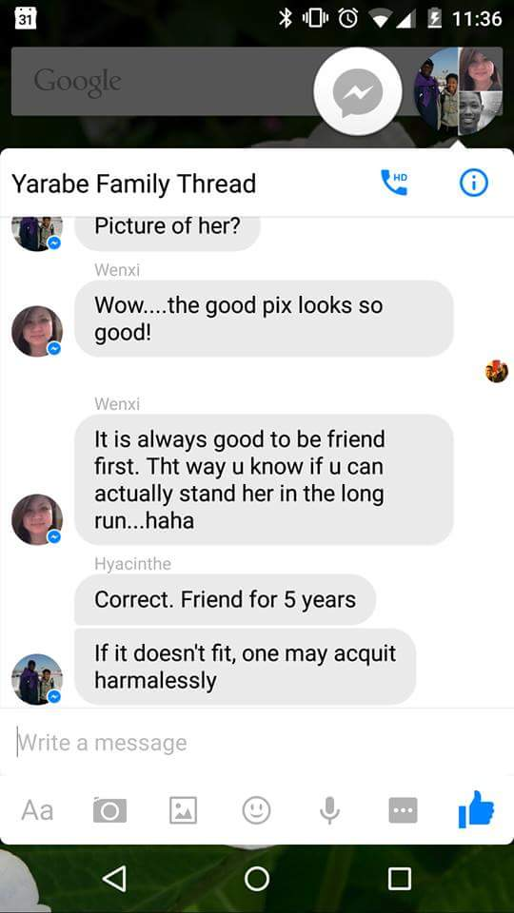
Message thread screenshot
Labels:
text
technology
screenshot
font
software
multimedia
mobile phone
Text:
31
Google
Yarabe Family Thread
HD
Picture of her?
Wenxi
Wow....the good pix looks so
good!
Wenxi
It is always good to be friend
first. Tht way u know if u can
actually stand her in the long
run...haha
Hyacinthe
Correct. Friend for 5 years
If it doesn't fit, one may acquit
harmalessly
rite a message
Notes:
After reporting to family a girl I was dating. Dad, she’s not a bloody glove. But OK, friend for 5 years. Good idea.

